Slide 1
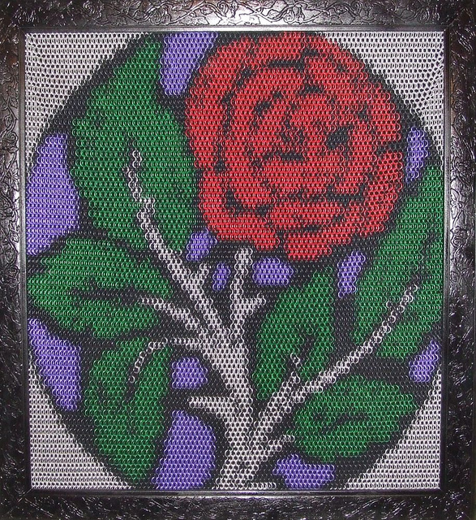
Chainmaille 102 Chainmaille harder!

Slide 2
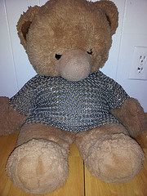
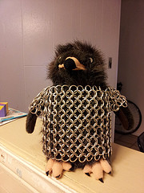
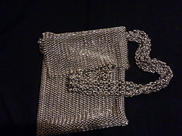
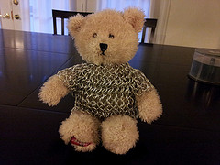
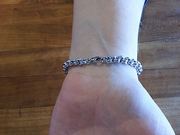

Slide 3
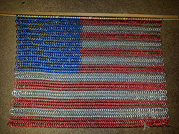
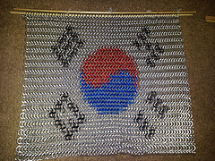
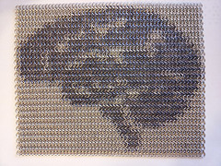
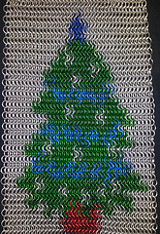

Slide 4
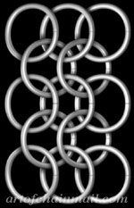
Today’s Goals:
European
4-in-1
Faster Construction

Slide 5
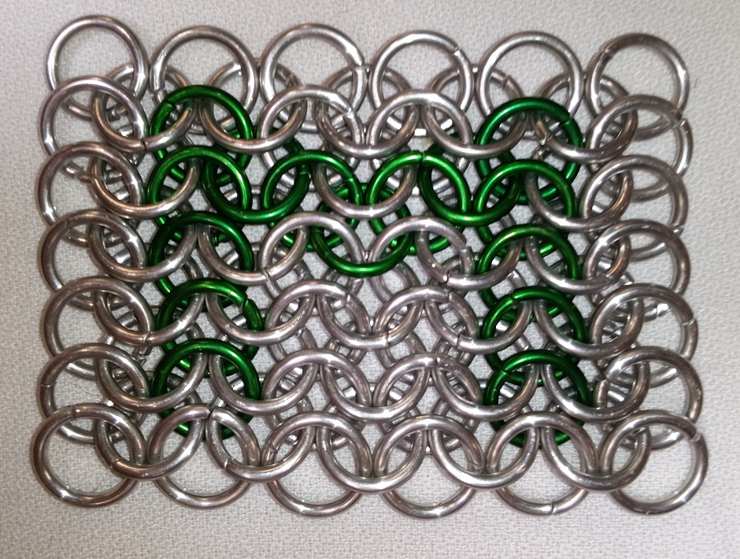
Inlays /
Color:
Assembled

Slide 6
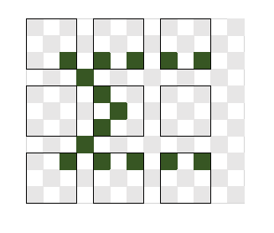
Inlays / Color – Pattern
Green Rings:
Open: 3
Closed: 12
Gray Rings:
Open: 27
Closed: 30

Slide 7
Step 1: Prepare the Parts!
Green Rings:
Open: 3
Closed: 12
Gray Rings:
Open: 27
Closed: 30

Slide 8
Step 2: Assemble the 1Us (Basic Units)

Slide 9
Step 3: Use the open rings to attach!

Slide 10
Step 4: Finished!

Slide 11
Feedback!
I’m Billy Van Ark
billy@malcondenver.org
Please let me know what you liked, what you didn’t like, and send me pictures of your completed projects!

